Slide 1
CS606 Al Planning and Decision Making
University Timetabling
Vu Viet Linh
Rao Ningzhen
Nguyen Thi Ngoc Anh
Huang Anni
Yang Guowei
Tang Jingxue
Notes:
Cover Slide with Image

Slide 2
Table of contents
Introduction
Problem Description
Solution Approach
Result
Demo
Notes:
(and project objective and scope
Educational timetabling is an ongoing challenging administrative task that is required in most aca_x0002_demic institutions. This is mainly due to a large number of constraints and requirements that have to be satisfied.
Introduce the ITC,
The biggest challenge is to generate a good solution within reasonable time.
In previous work, the MIP approach is very slow for large instances. Thereby we put forward a method where we don’t put objective function for the first round, and find
a better solution each time iterative until we meet the stopping criteria to save the time. Besides, we try to build a CP model and compare their results.

Slide 3
1. INTRODUCTION

Slide 4


1.Introduction
ITC 2019: International Timetabling Competition
courses
students
Goal: To find a proper time, a room and students for all the classes
https://www.itc2019.org/home
Notes:
The problem consists of university courses and student course requests. A course may have one or more classes such as one lecture and several seminars. A hierarchical course structure is defined to specify how students attend classes below in Figure 5. One class can have several meetings a week and must be scheduled at the same time and in the same room. It can be taught at either all or selected weeks of the semester. For example, a course may have two seminars of up to 20 students, and each seminar can take place on Mondays and Wednesdays at 9 am every other week, one seminar on odd weeks, the other on even weeks. The aim is to find a proper time, a room and students for all the classes. Each class has a set of acceptable time and room assignments, together with non-negative penalties that define their suitability. All students must be correctly assigned to classes of their requested courses. Distribution constraints express relations among a set of classes, e.g., seminars must be taught after the lecture each week. A feasible solution exists for each data instance and only feasible solutions are accepted in the com- petition. The overall solution cost should be minimized. It is computed as a weighted sum of all the time and room assignment penalties, penalties of broken soft distribution constraints, and the total number of student conflicts.

Slide 5


1.Introduction
Goal: find a proper time, a room and students for all the classes
rooms
students
Time
courses
https://www.itc2019.org/home
Notes:
The problem consists of university courses and student course requests. A course may have one or more classes such as one lecture and several seminars. A hierarchical course structure is defined to specify how students attend classes below in Figure 5. One class can have several meetings a week and must be scheduled at the same time and in the same room. It can be taught at either all or selected weeks of the semester. For example, a course may have two seminars of up to 20 students, and each seminar can take place on Mondays and Wednesdays at 9 am every other week, one seminar on odd weeks, the other on even weeks. The aim is to find a proper time, a room and students for all the classes. Each class has a set of acceptable time and room assignments, together with non-negative penalties that define their suitability. All students must be correctly assigned to classes of their requested courses. Distribution constraints express relations among a set of classes, e.g., seminars must be taught after the lecture each week. A feasible solution exists for each data instance and only feasible solutions are accepted in the com- petition. The overall solution cost should be minimized. It is computed as a weighted sum of all the time and room assignment penalties, penalties of broken soft distribution constraints, and the total number of student conflicts.

Slide 6
1.Introduction
Model used by competition participants
Mixed Integer Programming
Model used by us
Mixed Integer Programming
Constraint Programming
Notes:
The problem consists of university courses and student course requests. A course may have one or more classes such as one lecture and several seminars. A hierarchical course structure is defined to specify how students attend classes below in Figure 5. One class can have several meetings a week and must be scheduled at the same time and in the same room. It can be taught at either all or selected weeks of the semester. For example, a course may have two seminars of up to 20 students, and each seminar can take place on Mondays and Wednesdays at 9 am every other week, one seminar on odd weeks, the other on even weeks. The aim is to find a proper time, a room and students for all the classes. Each class has a set of acceptable time and room assignments, together with non-negative penalties that define their suitability. All students must be correctly assigned to classes of their requested courses. Distribution constraints express relations among a set of classes, e.g., seminars must be taught after the lecture each week. A feasible solution exists for each data instance and only feasible solutions are accepted in the com- petition. The overall solution cost should be minimized. It is computed as a weighted sum of all the time and room assignment penalties, penalties of broken soft distribution constraints, and the total number of student conflicts.

Slide 7
2. PROBLEM DEFINITION

Slide 8

2.Problem Definition
2.1 Data
rooms
courses
students
constraints
Notes:
Thank Jingxue, Now I will introduce our dataset. It has four components, namely rooms, courses, students, and constraints.

Slide 9

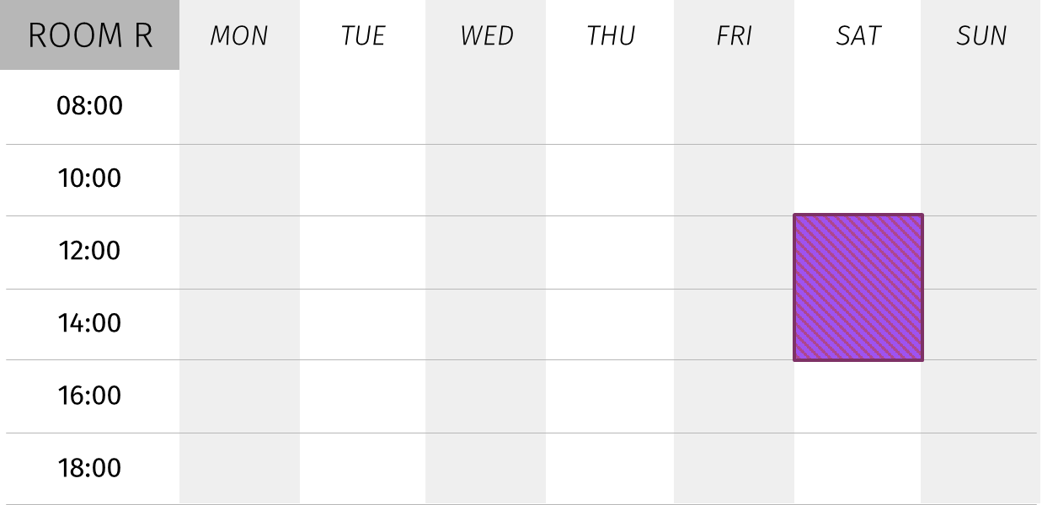
2.Problem Definition
2.1 Data
Rooms
capacity
The max students' number in one room
Not available on Sat noon
room r
Some rooms are not available at some time slots
unavailable
Notes:
First is rooms. Each room has its capacity, which means the maximum students’ number in a room.
And a room may not be available at some time slots, which is defined by the unavailable element.

Slide 10
2.Problem Definition
2.1 Data
Classes
Time
Room
t0
t1
r0
r1
r2
r3
r4
class C
t2
t3
r0
CS 606
Saturday 12:00pm – 3:15pm
SCIS SR2-2 (unavailable on week 4 Saturday noon)
SOE SR2-4
Notes:
Each class has a list of time and room options to choose from. But some rooms may not be available at some time slots.
For instance, let's assume that AI planning has one time option on Sat noon. And it has two room options, either in SCIS SR2-2 or SOE2-4.
But SCIS SR2-2 is not available on Sat noon on week 4, so we will schedule our class in SOE on week 4.

Slide 11

2.Problem Definition
2.1 Data
Courses
Each course has multiple subparts
Each subpart has multiple classes
A student need to choose one class in each subpart for each course
Some class has prerequisites
Course A
Subpart 20
Lecture
Subpart 21
Tutorial
Subpart 22
Lab
Class 120
Class 122
Class 125
Class 121
Class 123
Class 124
: precedence relationship
Notes:
The next is the course. It has a complex structure.
A course has many subparts, and many classes within a subpart.
For example, this course has three subparts, and each subpart has a list of classes.
A student needs to choose exactly one class in the three subparts.
Besides, some classes have prerequisites. Students also need to study the prerequisite class.

Slide 12
2.Problem Definition
2.1 Data
Students
classes
subparts
Lab1
Choose one lab
Lab
Lab2
Lecture1
Choose one lecture
Lecture
Lecture2
course c1
Lecture3
student S
course c2
Lecture
Notes:
The third component in our dataset is students.
Each student has a list of courses that he or she needs to study.
For example, this student wants to study two courses, the first course has two subparts: lab, and lecture.
So this student needs to choose one lab class and one lecture for course 1.

Slide 13
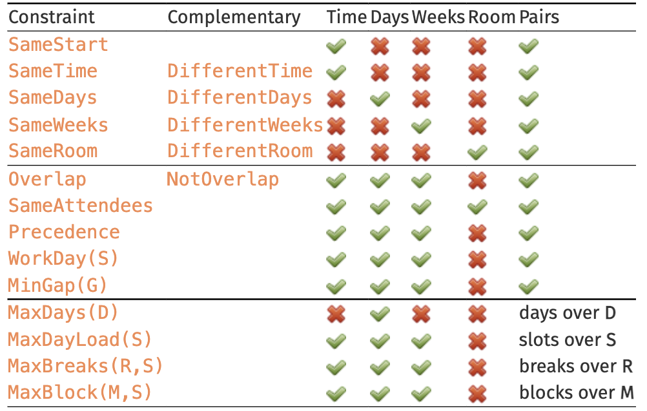
2.Problem Definition
2.1 Data
Distributed Constraints
We only consider hard constraints: SameAttendees in this project
Notes:
Besides the pre-defined constraints, we also have extra distribution constraints in our dataset. They can be soft or hard constraints as listed in this table.
Since these constraints are computationally heavy, we removed all the soft constraints and only consider the SameAttendees in distributed constraints.

Slide 14
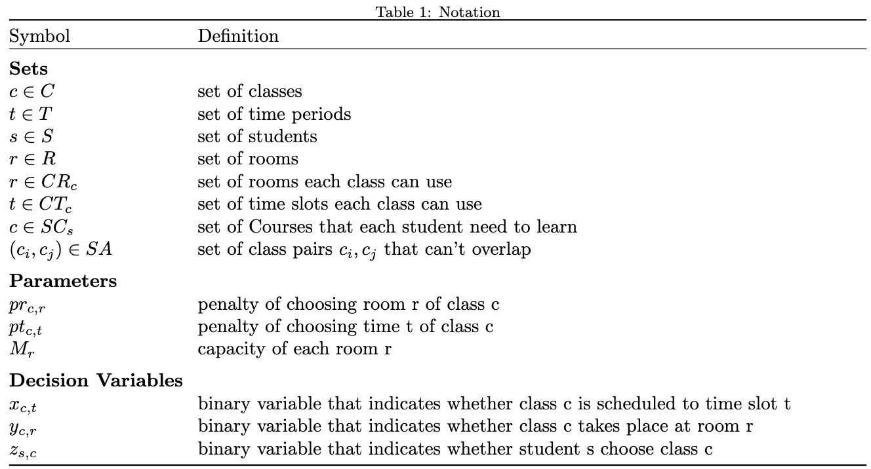
2.Problem Definition
2.2 Notations
Notes:
Here are the notations we use for our two models.
They are a class set C, room set R, time period set T, and student set S.
For penalty, we have two kinds of penalty pr, and pt for the penalty of choosing specific room and time slot respectively.
Besides, here are the three decision variables x, y, z which will be explained by my teammate later.

Slide 15
2.Problem Definition
2.3 Assumptions
There’s no travel time between two classes.
Do not consider soft constraints and only consider SameAttendees in distributed constraints.
Notes:
In conclusion, we made two assumptions for our project.
The first is that we do not consider travel time between two classes. Students can attend another class immediately after one class.
The second is that we removed all the soft constraints and only consider SameAttendees for the distributed constraints.
Now, welcome Ningzhen to introduce the rest of our problem definition.

Slide 16
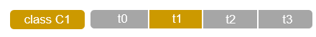
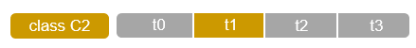
2. Problem Definition (MP)
Decision variables
No global identifier for timeslot
Notes:
Thank you anni, I will introduce the decision variables, objectives and constraints of our models.
The key challenge for our project is that the time slot is very flexible, unlike the class example in which one day only contains 3 time slots. In our project,
Given the flexible starting time, the flexible ending time, the flexible days in week when there is class. Our problem can have infinite time slots.
So we cannot get a unique id for each timeslot.
To solve this problem, we instead used a not-unique t as index to get available timeslot only for each class. Meaning t1 for class 1 is not the same with t1 for class 2, we then write functions to check whether 2 timeslot will clash. This strategy is implemented for both our mp and cp models.
Our decision variables of MP model. Binary variable dict x for time y for room z for enrollment

Slide 17
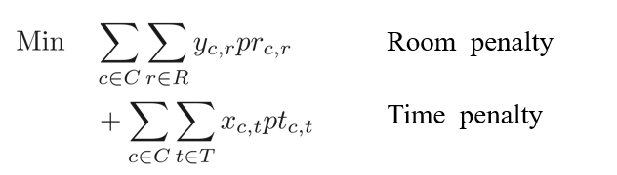
2. Problem Definition (MP)
Objective

Slide 18
2.Problem Definition (MP)
Constraints
H1: Every class must be assigned a time
H2: Every class must be assigned a room
H3: Every student must attend exactly one class for each subpart that he/she must attend

Slide 19
2.Problem Definition (MP)
Constraints
H4: Prerequisite:
Ex: If you take AI Planning – you must take Algorithm as well
H5: The capacity limit of each class must not be exceeded.
H6: A room cannot be used when it is unavailable
H7: The pairs of classes in SameAttendees should not overlap in time
Ex: Prof Dai is teaching Algorithm & Applied ML – these 2 classes cannot happen at the same time
H8: Two classes can’t be at the same time and the same room
Notes:
For the model solving, we tried to include all these

Slide 20
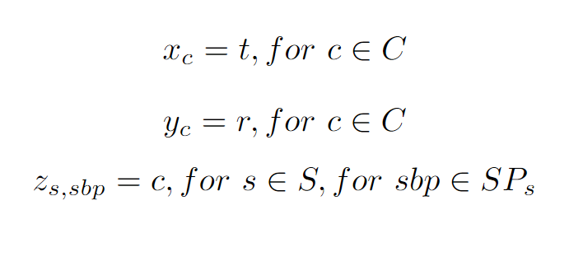
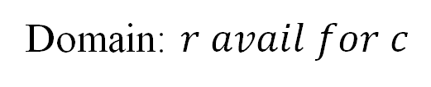
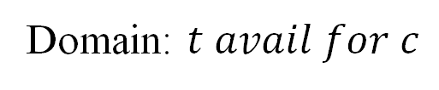
2. Problem Definition (CP)
Decision variables
Domain: $t avail for c$
Domain: $r avail for c$
Domain: c in SPs
Time for class c is t
Room for class c is r
The class choice of subpart sbp for student s is c
Notes:
Integer variable lists instead of binary variable dict for mp, fewer dv

Slide 21
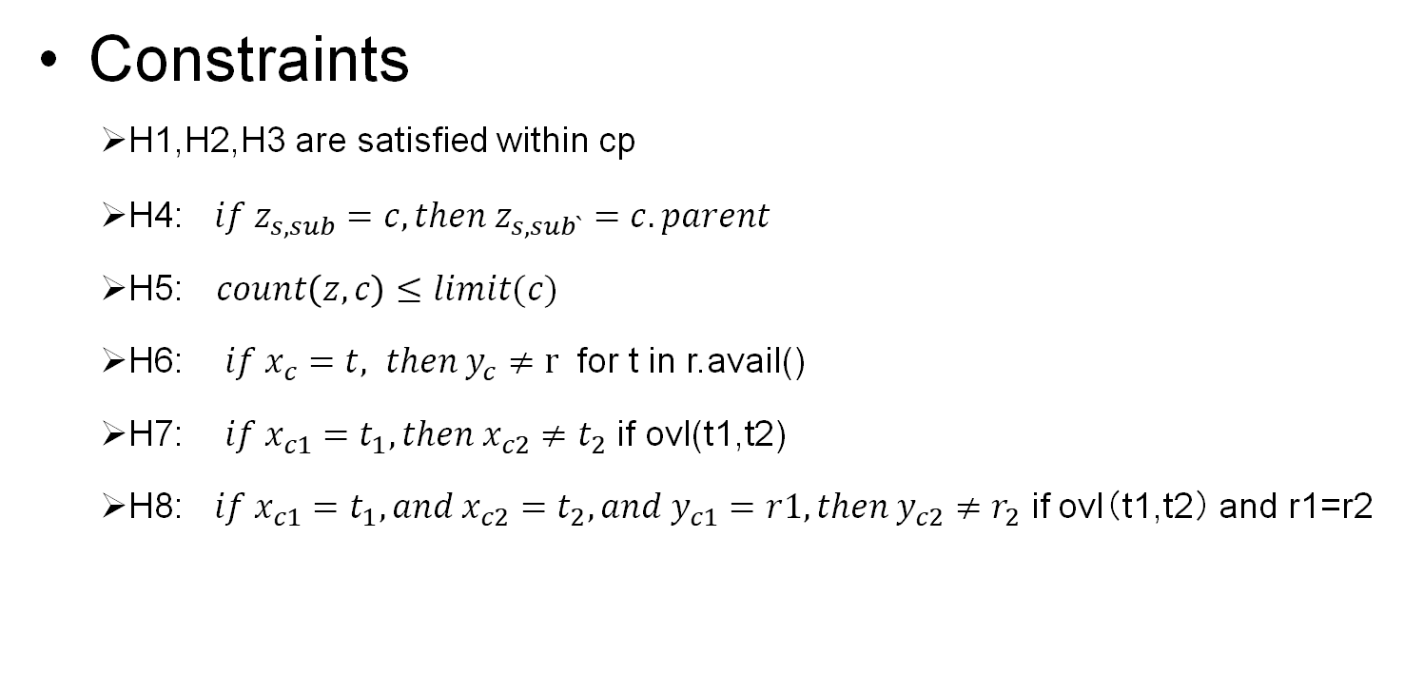
2. Problem Definition (CP)
Objective
$$min\sum_{c}{(p_{t_{c}}+p_{r_{c})}}$$
Constraints
H1,H2,H3 are satisfied within cp
H4: $if z_{s,sub}=c, then{ z}_{s,sub`}=c.parent$
H5:$count\left(z,c\right)≤limit(c)$
H6: $if x_{c}=t, then y_{c}≠r$ for t in r.avail()
H7: $if x_{c1}=t_{1},then x_{c2}{≠t}_{2}$ if ovl(t1,t2)
H8: $if x_{c1}=t_{1},and x_{c2}=t_{2}, and{ y}_{c1}=r1,then y_{c2}{≠r}_{2}$ if ovl（t1,t2） and r1=r2
Notes:
The obj and constraint for cp is similar to mp, but h1,h2,h3 are automatically satisfied. So we do not need to include them.

Slide 22
3. SOLUTION APPROACH

Slide 23
3. Solution Approach
Mixed Integer Programming
Binary variables
Linear constraints
Time
Room
t0
t1
t2
t3
r0
r1
r2
r3
r4
class C
0
1
0
0
0
0
0
0
1
course 20
course 22
c11
c12
c16
c17
c18
student S
0
1
0
1
0

Slide 24







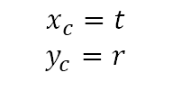
3.Solution Approach
Constraint Programming
Integer variables:
Logical constraints:
if_else
logical_and
$$x_{c}=t$$
$$y_{c}=r$$
class C
t0
t1
t2
t3
$$x_{c}=1$$
$$z_{s,sbp}=c$$
r0
r1
r2
r3
r4
$$y_{c}=4$$
course 20
c11
c12
$$z_{s,20}=12$$
student S
course 22
c16
c17
c18
$$z_{s,22}=17$$
Notes:
The constraints for constraint programming are the same as the ones in mathematical programming. But it has different decision variables. In mixed integer programming, the decision variables are all bool variables while in constraint programming, they are integers. For example, xc denotes the time options for each class c, while in mixed integer programming, we use a bool variable xc,t to do that.

Slide 25
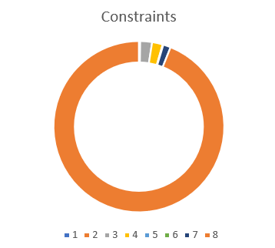
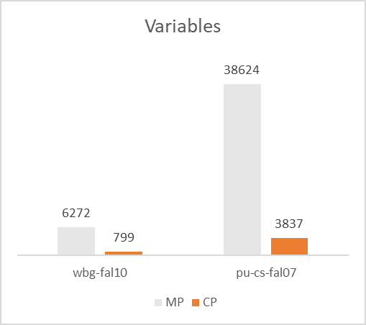
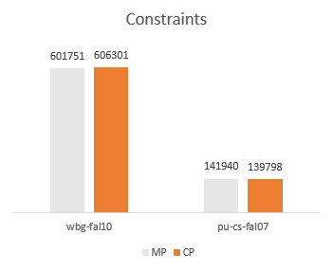
3.Solution Approach
94%
Notes:
The constraints for constraint programming are the same as the ones in mathematical programming. But it has different decision variables. In mixed integer programming, the decision variables are all bool variables while in constraint programming, they are integers. For example, xc denotes the time options for each class c, while in mixed integer programming, we use a bool variable xc,t to do that.

Slide 26

3. Solution Approach
Decision variables
Solution
Constraints
Objective
*cannot finished in 8 hrs !

Slide 27

3. Solution Approach
Mixed Integer Programming
Decision variables
Feasible solution
Constraints
* First feasible solution found after ~5 seconds

Slide 28
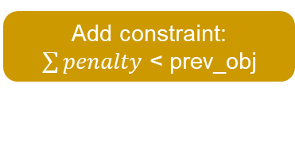
3. Solution Approach
Mixed Integer Programming
Decision variables
Feasible solution
Constraints
Calculate objective value
(e.g prev_obj = 2022)
Add constraint:
$\sum{penalty}$ < prev_obj

Slide 29
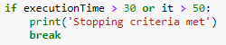

3. Solution Approach
Mixed Integer Programming
Decision variables
Feasible solution
Constraints
Calculate objective value
(e.g prev_obj = 2022)
Add constraint:
$\sum{penalty}$ < prev_obj
Stopping criteria: either
number of iterations > 50
time for an iteration exceed 30s

Slide 30
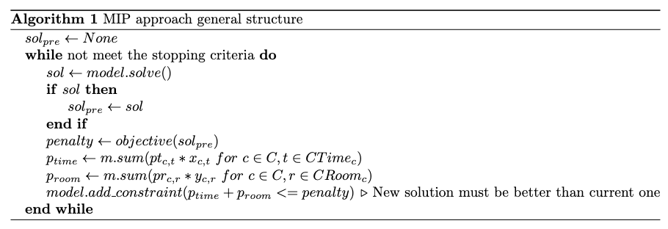
3. Solution Approach
Mixed Integer Programming

Slide 31

3. Solution Approach
Constraint Programming
Decision variables
Feasible solution
Constraints
* First feasible solution found after ~800 seconds

Slide 32
3. Solution Approach
Constraint Programming
Decision variables
Solution
Constraints
Objective
stop after 1000 seconds

Slide 33
4. RESULTS

Slide 34
4.Results
First feasible solution
Runtime
Objective
Optimal solution
Notes:
MP is always quicker than CP to find a feasible solution. And it can find the optimal solution quicker on small dataset, while CP can find the optimal solution quicker on large dataset

Slide 35
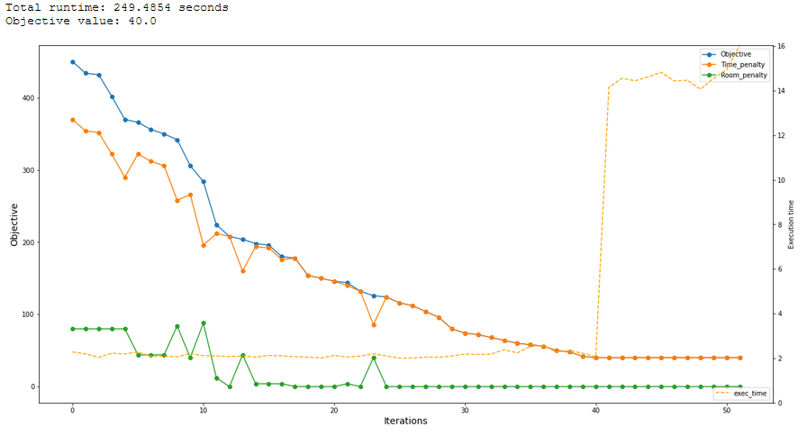
MIP approach result

Slide 36
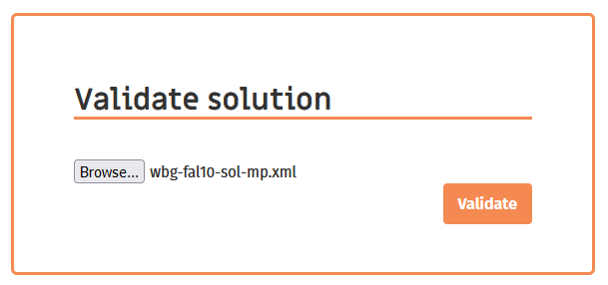
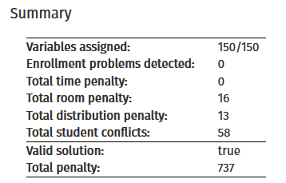
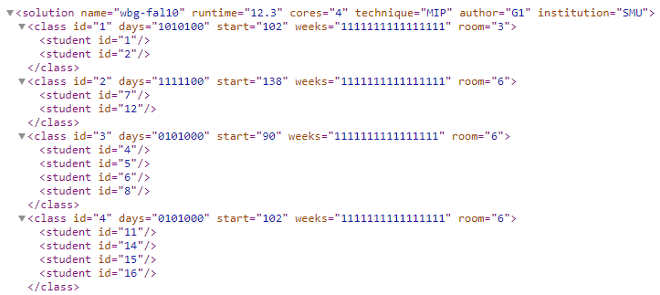
Validation
Notes:
Best penalty:
Wbg-fal10: 36 Room penalty:16
Pu-cs-fal17: 200 Room penalty: 24, Time penalty: 56

Slide 37
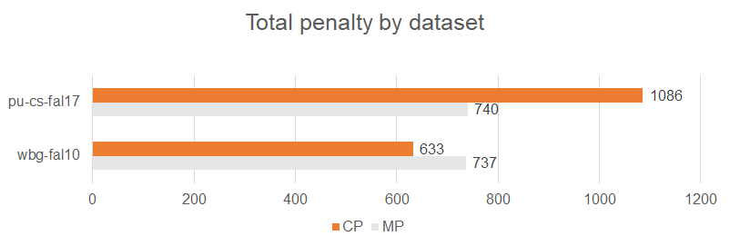
Validation

Slide 38
5. Demo
Colab: MIP
Colab: CP

Slide 39
Q&A

